Slide 1



Slide 2



01CE1503 - Design and Analysis of Algorithm
Unit - 1
Introduction and Analysis of Algorithms
Prof. Mitul Takodara
Department of Computer Engineering

Slide 3



OUTLINE
Characteristics of Algorithm
The efficient algorithm, Average, Best and Worst case analysis
Asymptotic Notations (Big Oh, Big Theta, Big Omega)
Amortized analysis
Master Method
Sorting Algorithms and analysis: Bubble sort, Selection sort, Insertion sort, Shell sort, Heap sort
Sorting in linear time : Bucket sort, Radix sort, Counting sort

Slide 4
OUTLINE
Unambiguous − Algorithm should be clear and unambiguous. Each of its step (or phases), and their input/outputs should be clear and must lead to only one meaning.
Input − An algorithm should have 0 or more well defined inputs.
Output − An algorithm should have 1 or more well defined outputs, and should match the desired output.
Finiteness − Algorithms must terminate after a finite number of steps.
Feasibility − Should be feasible with the available resources.
Independent − An algorithm should have step-by-step directions which should be independent of any programming code.

Slide 5
THE EFFICIENT ALGORITHM
The efficiency of an algorithm defines the number of computational resources used by an algorithm and time taken by an algorithm to produce the desired result.
An algorithm which takes fewer resources and computes results in a minimum time for a problem then that algorithm is known as efficient.
The efficiency of an algorithm depends on its design, implementation, resources, and memory required by it for the computation.
Since every algorithm uses computer resources to run, But to analyse an algorithm, execution time and internal memory are essential to consider.

Slide 6
THE EFFICIENT ALGORITHM
Problem: Sorting the elements of array X in ascending order.
How to solve?
When we have a problem to solve, there may be several suitable algorithms available.
We would obviously like to choose the best.
This raises the question of how to decide which of several algorithms is preferable.
If we have only one or two small instances of a rather simple problem to solve,
we may not care too much which algorithm we use.
However if we have lots of instances to solve, or if the problem is hard,
we may have to choose more carefully.

Slide 7
THE EFFICIENT ALGORITHM
The empirical (or a posteriori) approach:
We write the programs for various competing techniques and then that programs is tested on the computer using different instances.
The theoretical (or a priori) approach:
Determining mathematically the quantity of resources needed by each algorithm as a function of the size of the instances considered.
Hybrid Approach:
Function that define the Algorithms efficiency is determined by theoretically approach and then numerical parameters are determined by empirical when program executes on machine.

Slide 8
THE EFFICIENT ALGORITHM
The principle of Invariance
Two different implementation of the same algorithm will not differ much in efficiency.
Difference can be expressed using multiplicative constant.
If algorithm take t1(n) time and another take t2(n) time,
Then t1(n) <= c.t2(n) or t2(n) <= d.t1(n), where c and d are some constant.
This principle allows us to express time taken by the algorithm in terms of multiplicative constant.

Slide 9
THE EFFICIENT ALGORITHM
Order of Growth
Order of growth of an algorithm is a way of predicting how execution time of a program and the space/memory occupied by it changes with the input size.
Efficiency Class | Order of Growth | Description | Example
Constant | 1 | As input size grows we get larger running time | Scanning array elements.
Logarithmic | logn | Problem is divided into smaller parts on each iteration. | Binary Search
Linear | n | Running time is dependent on input size | Sequential search
nlogn | nlogn | Some instance of algorithm considered for list of size n | Merge sort and quick sort
Quaderatic | n² | Algorithm has 2 nested loops | Scanning matrix elements
Cubic | n³ | Algorithm has 3 nested loops | Perform matrix multiplication
Exponential | 2^{n} | Algorithm has faster rate of growth | Generating subset of all n elements
Factorial | n! | Algorithms compute permutation | All permutation

Slide 10
THE EFFICIENT ALGORITHM
Order of Growth
n | 1 | logn | sqrt(n) | n | nlogn | n2 | n3 | 2^n | n!
1 | 1 | 0 | 1.000 | 1 | 0 | 1 | 1 | 2 | 1
2 | 1 | 1 | 1.414 | 2 | 2 | 4 | 8 | 4 | 2
4 | 1 | 2 | 2.000 | 4 | 8 | 16 | 64 | 16 | 24
8 | 1 | 3 | 2.828 | 8 | 24 | 64 | 512 | 256 | 40320
16 | 1 | 4 | 4.000 | 16 | 64 | 256 | 4096 | 65536 | 2.09228E+13
32 | 1 | 5 | 5.657 | 32 | 160 | 1024 | 32768 | 4294967296 | 2.63131E+35
64 | 1 | 6 | 8.000 | 64 | 384 | 4096 | 262144 | 1.84467E+19 | 1.26887E+89

Slide 11
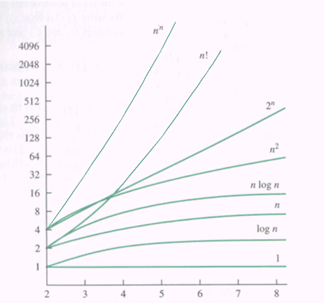
THE EFFICIENT ALGORITHM
Order of Growth

Slide 12
THE EFFICIENT ALGORITHM
Arrange from smallest to largest or in increasing order
1) 2^{n}, nlogn, n² ,1, n, logn, n!, n³
1, logn, n, nlogn, n² , n³ , 2^{n} ,n!
2) nlogn, n+n²+n³, 2^{n}, sqrt(n)
Sqrt(n), nlogn, n+n²+n³, 2^{n}
3) n², 2^{n}, nlogn, logn, n³
logn, nlogn, n², n³,2^{n}
n!, 2^{n}, (n+1)!,2^{2n}, n^{n}, n^{logn}
n^{logn} , 2^{n} , n!, (n+1)!, 2^{2n}, n^{n}

Slide 13
ANALYSIS OF ALGORITHM
What is the goal of analysis of algorithms?
To compare algorithms mainly in terms of running time but also in terms of other factors (e.g., memory requirements, programmer's effort etc.)
What do we mean by running time analysis?
Determine how running time increases as the size of the problem increases.
Input size
# of elements in the array
# of elements in a matrix
# of bits in the binary representation of the input
vertices and edges in a graph, etc.
Types of analysis:
Best case Time complexity
Worst case Time complexity
Average case Time complexity

Slide 14
ANALYSIS OF ALGORITHM
Best case Time complexity:
If an algorithm takes minimum amount of time to execute a specific set of input then it is called best case time complexity.
Provides a lower bound on running time
Worst case Time complexity:
If an algorithm takes maximum amount of time to execute a specific set of input then it is called worst case time complexity.
Provides an upper bound on running time
Average case Time complexity:
If an algorithm takes average amount of time to execute a specific set of input then it is called average case time complexity.
Provides a prediction about the average running time

Slide 15
ANALYSIS OF ALGORITHM
How do we compare algorithms?:
We need to define a number of objective measures.
1. Compare execution times? Not good: times are specific to a particular computer !!
2. Count the number of statements executed? Not good: number of statements vary with the programming language as well as the style of the individual programmer.
Ideal Solution:
Express running time as a function of the input size n (i.e., f(n)).
Compare different functions corresponding to running times.
Such an analysis is independent of machine time, programming style, etc.

Slide 16
ASYMPTOTIC NOTATIONS
What is Asymptotic Notation?
Whenever we want to perform analysis of an algorithm, we need to calculate the complexity of that algorithm.
But when we calculate the complexity of an algorithm it does not provide the exact amount of time/resource required.
So instead of taking the exact amount of time/resource, we represent that complexity in a general form (Notation) which produces the basic nature of that algorithm.

Slide 17
ASYMPTOTIC NOTATIONS
What is Asymptotic Notation?
Asymptotic notation of an algorithm is a mathematical representation of its complexity.
There are three notations that are commonly used.
Big - Oh (O)
Big - Omega (Ω)
Big - Theta (Θ)

Slide 18
ASYMPTOTIC NOTATIONS
Big - Oh (O)
Big - Oh notation is used to define the upper bound of an algorithm in terms of Time Complexity.
That means Big - Oh notation always indicates the maximum time required by an algorithm for all input values.
That means Big - Oh notation describes the worst case of an algorithm time complexity.
Big - Oh Notation can be defined as follows...

Slide 19
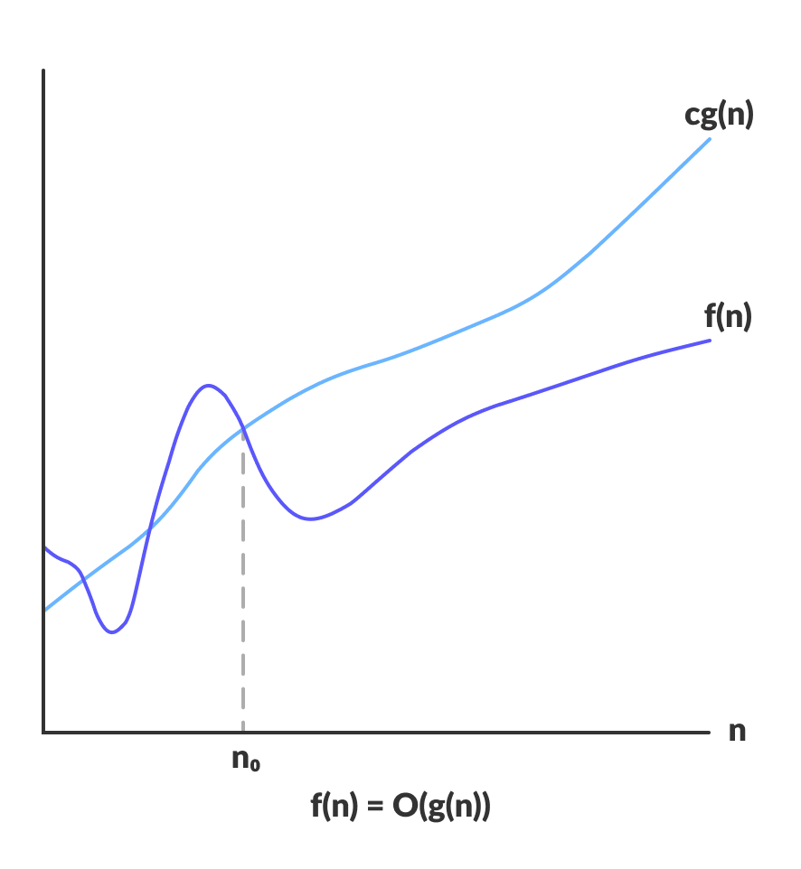
ASYMPTOTIC NOTATIONS
Big - Oh (O)
Consider f(n) is your algorithm runtime, and g(n) is an arbitrary time complexity you are trying to relate to your algorithm.
f(n) is O(g(n)),
if for some real constants c (c > 0) and n₀ >=1, f(n) <= c* g(n)
for every input size n (n > n₀)

Slide 20
ASYMPTOTIC NOTATIONS
Big - Oh (O)
Example : f(n) = 2n+2 , g(n) = n² , Is f(n) O(g(n²))?
2n+2 <= c* n²
c= 1
2n+2 <= n²
For n>2 we can obtain f(n) < g(n).
n | f(n)=2n+2 | g(n)=n² | f(n)<=c*g(n)
1 | 4 | 1 | f(n)>g(n)
2 | 6 | 4 | f(n)>g(n)
3 | 8 | 9 | f(n)<g(n)
4 | 10 | 16 | f(n)<g(n)
5 | 12 | 25 | f(n)<g(n)

Slide 21
ASYMPTOTIC NOTATIONS
Big - Oh (O)
Example : Consider the following f(n) and g(n)... f(n) = 3n + 2 g(n) = n
If we want to represent f(n) as O(g(n)) then
it must satisfy f(n) <= c *g(n) for all values of c > 0 and n₀>= 1
f(n) <= c * g(n) ⇒ 3n + 2 <= c*n
Above condition is always TRUE for all values of C = 4 and n >= 2.
By using Big - Oh notation we can represent the time complexity as follows... 3n + 2 = O(n)

Slide 22
ASYMPTOTIC NOTATIONS
Big - Oh (O)
Example : Show that 30n+8 is O(n).
f(n) < = c * g(n)
30n+8 < = c* n
Find value of c such that f(n)
is always less than g(n).
Put c = 31
30n+8 <= 31*n
n >= 8
n | f(n)=30n+8 | g(n)=c*n | f(n)<=c*g(n)
1 | 38 | 31 | f(n)>g(n)
2 | 68 | 62 | f(n)>g(n)
3 | 98 | 93 | f(n)>g(n)
4 | 128 | 124 | f(n)>g(n)
5 | 158 | 155 | f(n)>g(n)
6 | 188 | 186 | f(n)>g(n)
7 | 218 | 217 | f(n)>g(n)
8 | 248 | 248 | f(n)<=g(n)
9 | 278 | 279 | f(n)<=g(n)
10 | 308 | 310 | f(n)<=g(n)

Slide 23
ASYMPTOTIC NOTATIONS
Big - Oh (O)
Example :
Prove that: 20n² + 2n + 5 = O(n²)
f (n) < = c * g (n)
20n² + 2n + 5 < = c* n²
Let c = 21 (so 20n² < 21 n²)
2n+ 5 <= n² (n > 4)
So for c= 21 and n>=4 is is proved O(n²)
n | 20n²+2n+5 | 21n² | f(n)<=c*g(n)
1 | 27 | 21 | f(n)>g(n)
2 | 89 | 84 | f(n)>g(n)
3 | 191 | 189 | f(n)>g(n)
4 | 333 | 336 | f(n)<g(n)
5 | 515 | 525 | f(n)>g(n)
6 | 720 | 756 | f(n)>g(n)
7 | 980 | 1029 | f(n)>g(n)

Slide 24
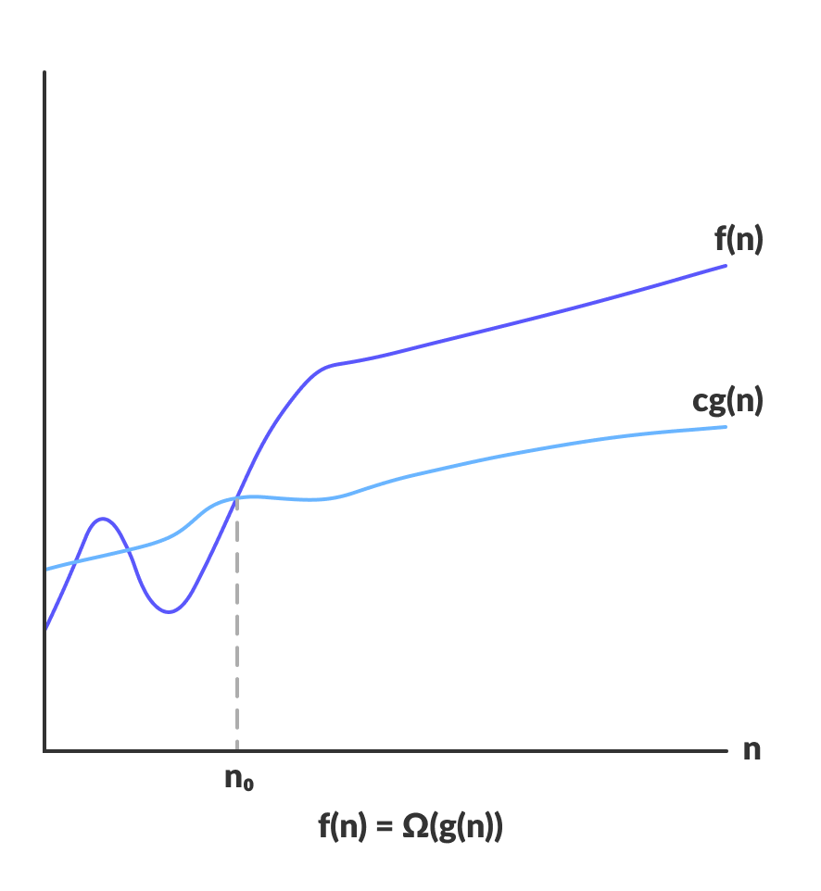
ASYMPTOTIC NOTATIONS
Big-Omega (Ω)
Big - Omega is an Asymptotic Notation for the best case.
Ω notation provides an asymptotic lower bound.
The Omega notation is the least used notation among all three.
f(n) is Ω(g(n)),
if for some real constants c (c > 0) and n₀ (n₀> = 1 ),
f(n) >= c * g(n)
for every input size n (n > n₀).

Slide 25
ASYMPTOTIC NOTATIONS
Big-Omega (Ω)
1) f(n) = 2n²+n , Is f(n) Ω(g(n²))?
2n² + n >= c* n²
C = 2
2n² + n >= 2* n²
n > 0
For n>0 we can obtain f(n) > g(n).
2) f(n) = 5n² , Is f(n) Ω(g(n))?
5n² >= c*g(__)
5n² >= c*n
5n² >= 1 *n
n > 1, c=1

Slide 26
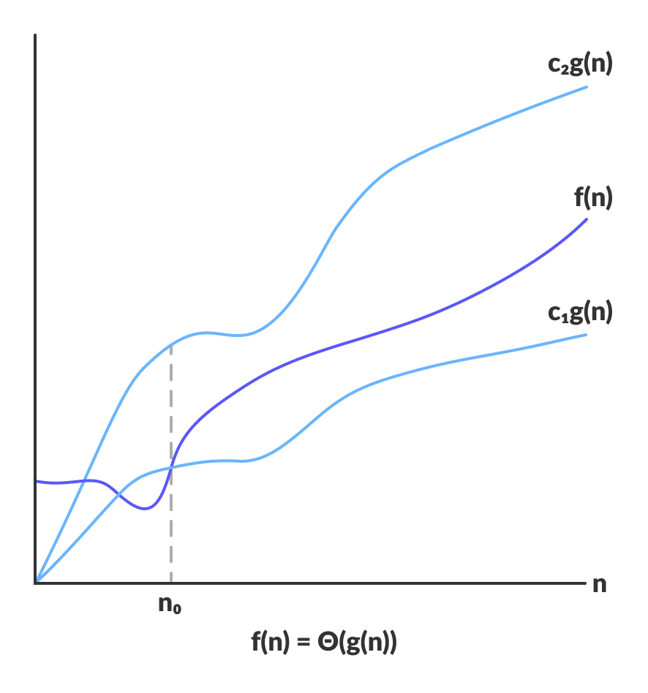
ASYMPTOTIC NOTATIONS
Big- Theta (Θ)
Theta (Θ) denote the asymptotically tight bound (average case) on the growth rate of runtime of an algorithm.
f(n) is Θ(g(n)),
if for some real constants c1, c2 and n₀
(c1 > 0, c2 > 0, n₀ > 0),
C1*g(n) < f(n) < c2*g(n)
for every input size n (n > n₀).

Slide 27
ASYMPTOTIC NOTATIONS
Big- Theta (Θ)
Example : f(n) = 2n²+n , Is f(n) θ(g(n²))?
c1 *n² <= 2n²+n <= c2*n²
c1 = 2, c2 = 3
2*n² <=2n²+n <= 3* n²

Slide 28
AMORTIZED ANALYSIS
Amortized Analysis is used for algorithms where an occasional operation is very slow, but most of the other operations are faster. In Amortized Analysis, we analyse a sequence of operations and guarantee a worst-case average time that is lower than the worst-case time of a particularly expensive operation.
There are three different approaches to amortized analysis:
Aggregate method
Accounting method
Potential method

Slide 29
AMORTIZED ANALYSIS
The Augmented Stack
Consider a stack S that has the following operations:
Push(S, x) pushes an element x onto the stack S
Pop(S) pops the top element x of S and returns x
Multipop(S, k) pops the min(k, S) top elements of S
Running time: Push(S,x) is O(1), Pop(S) is O(1),
Multipop(S,k) is O(min(k,S))

Slide 30
AMORTIZED ANALYSIS
Aggregate Method
Suppose that a sequence of n operations takes T(n) time.
Then the amortized cost per operation is defined to be T(n)/n.
The amortized cost applies to each operation, even when there are several different types of operations.
In a sequence of n operations, the stack never holds more than n elements. Thus, the cost of a multipop operation is O(n).
It follows that the worst-case running time of any sequence of n stack operations is O(n^2). However, this is an over-estimate!

Slide 31
AMORTIZED ANALYSIS
The total number of pops or multipops in the entire sequence of operations is <= the total number of pushes.
Suppose that the maximum number of Push operations in the sequence is n. So the time for entire sequence is O(n).
Amortized cost per operation: O(n)/n = O(1).

Slide 32
AMORTIZED ANALYSIS
Accounting Method
We assign an amortized cost to each operation, where the actual cost might be lower or higher than the amortized cost.
The sum of all the amortized costs in a sequence must be at least the sum of all the actual costs, since we would like to bound the total cost of the sequence by the sum of amortized costs.
How can we ensure this property?

Slide 33
AMORTIZED ANALYSIS
For each operation in the sequence, we have
if the amortized cost > actual cost then the difference is stored as a credit with an object in the data structure.
if the amortized cost < actual cost then use stored credits to make up for the difference.
We have to use stored credit when amortized cost is less than actual cost to make up for the difference, so that sum of costs is always nonnegative.

Slide 34
AMORTIZED ANALYSIS
Accounting Method for stack
Let us use the following amortized costs:
Push: 2
Pop: 0
Multipop: 0
The Push operation has cost 1; the additional 1 is stored as credit with the pushed element.
There is always enough credit to pay for each operation.
Each amortized cost is O(1)
Thus, the cost of the entire sequence of n operations is O(n)

Slide 35
AMORTIZED ANALYSIS
Potential Method
in this we use some potential energy to pay for future operation. Instead of associating potential with specific object we can associate potential with whole DS.
𝐭𝐢′=𝐭𝐢+ 𝛗(𝐃𝐢) − 𝛗(𝐃𝐢−𝟏)
(Actual cost + potential change)
Where, Di = cost of ith operation
Ф(Di) = potential of Di
ti` = amortized cost with ith operation
ti = actual cost

Slide 36
SORTING ALGORITHMS AND ANALYSIS
A Sorting algorithm is an algorithm that puts elements of a list/array into an order.
i.e. : Bubble sort, Selection sort, Insertion sort, Shell sort, Heap sort
Real life examples :
The contact list in your phone.
While shopping online, you sort items based on your choice, that is, price low to high or high to low, ratings, etc.

Slide 37
BUBBLE SORT
Bubble sort is a simple sorting algorithm.
In this algorithm each pair of adjacent elements is compared and the elements are swapped if they are not in order.
It is called bubble sort because the movement of array elements is just like the movement of air bubbles in the water.
Bubbles in water rise up to the surface; similarly, the array elements in bubble sort move to the end in each iteration.
This algorithm is not suitable for large data sets as its average and worst case complexity are of Ο(n²) where n is the number of items.

Slide 38
BUBBLE SORT
Bubble Sort Algorithm
Starting with the first element(index = 0), compare the current element with the next element of the array.
If the current element is greater than the next element of the array, swap them.
If the current element is less than the next element, move to the next element. Repeat Step 1.
If we have total N elements, then we need to repeat this process for N-1 times.

Slide 39
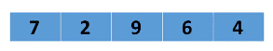
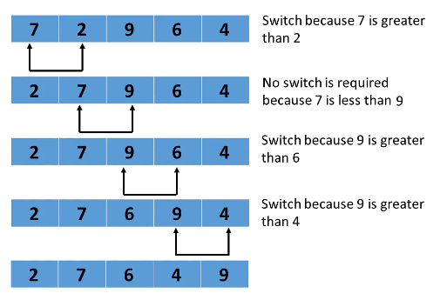
BUBBLE SORT
How Does the Bubble Sort Algorithm Work?
First Pass

Slide 40
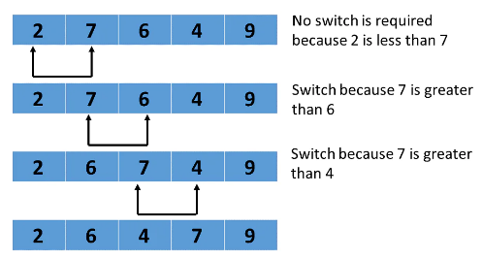
BUBBLE SORT
Second Pass
The process is repeated for the remaining iterations.

Slide 41
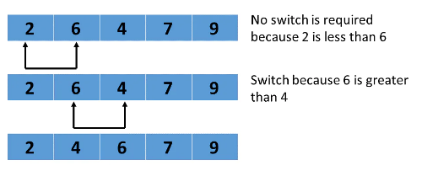
BUBBLE SORT
Third Pass
The comparison is performed up to the last unsorted element in each iteration.

Slide 42
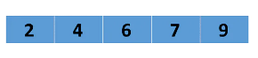
BUBBLE SORT
Fourth Pass
When all of the unsorted elements are placed in their correct positions, the array is sorted.
Demo visualization (Just for reference)
https://visualgo.net/en/sorting

Slide 43
BUBBLE SORT
Bubble Sort Algorithm
In the algorithm given below, suppose arr is an array of n elements.
The assumed swap function in the algorithm will swap the values of given array elements.
begin BubbleSort(arr)
for all array elements
if arr[i] > arr[i+1]
swap(arr[i], arr[i+1])
end if
end for
return arr
end BubbleSort

Slide 44
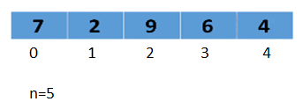
BUBBLE SORT
Implementations of Bubble Sort
for (int i = 0; i < n - 1; i++)
{
for (int j = 0; j < n - i - 1; j++)
{
if (arr[j] > arr[j + 1])
{
// swap arr[j+1] and arr[j]
temp = arr[j];
arr[j] = arr[j + 1];
arr[j + 1] = temp;
}
}
}

Slide 45
BUBBLE SORT
Time complexity
Now let us discuss the time complexity in best, average, and the worst case.
Worst Case: O(n²) - The worst-case occurs when we want to sort a list in ascending order, but it is arranged in descending order.
Average Case: O(n²) - The average case is when the list is arranged in a jumbled order.
Best Case: O(n) - The best-case occurs when the list is already arranged in the desired order.

Slide 46
SELECTION SORT
Selection sort is a sorting algorithm that selects the smallest element from an unsorted list in each iteration and places that element at the beginning of the unsorted list.
The algorithm maintains two sub arrays in a given array.
1. The sub array which is already sorted.
2. Remaining sub array which is unsorted.
In every iteration of selection sort, the minimum element (considering ascending order) from the unsorted sub array is picked and moved to the sorted sub array.

Slide 47
SELECTION SORT
Algorithm of the Selection Sort
The selection sort algorithm is as follows:
Step 1 − Set min to the first location
Step 2 − Search the minimum element in the array
Step 3 – swap the first location with the minimum value in the array
Step 4 – assign the second element as min.
Step 5 − Repeat the process until we get a sorted array.
Demo : https://visualgo.net/en/sorting

Slide 48
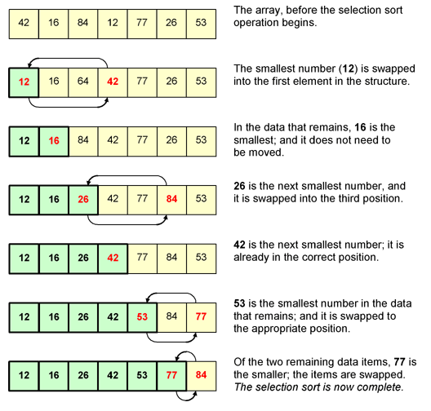
SELECTION SORT
Selection Sort Example

Slide 49
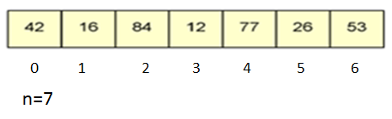
SELECTION SORT
Implementations of Selection Sort
for (i = 0 ; i < n-1 ; i++)
{
min = i;
for(j = i+1 ; j < n ; j++)
{
if(A[j] < A[min])
min = j;
}
temp = A[i];
A[i] = A[min];
A[min] = temp;
}
i = variable to traverse the array A
min = variable to store the index of minimum element
j = variable to traverse the unsorted sub-array
temp = temporary variable used for swapping

Slide 50
SELECTION SORT
Time complexity
Best Case Complexity: The selection sort algorithm has a best-case time complexity of O(n²) for the already sorted array.
Average Case Complexity: The average-case time complexity for the selection sort algorithm is O(n²), in which the existing elements are in jumbled ordered, i.e., neither in the ascending order nor in the descending order.
Worst Case Complexity: The worst-case time complexity is also O(n²), which occurs when we sort the descending order of an array into the ascending order.
In the selection sort algorithm, the time complexity is O(n²) in all three cases. This is because, in each step, we are required to find minimum elements so that it can be placed in the correct position. Once we trace the complete array, we will get our minimum element.

Slide 51
INSERTION SORT
Insertion sort is a simple sorting algorithm that works similar to the way you sort playing cards in your hands.
We assume that the first card is already sorted then, we select an unsorted card.
If the unsorted card is greater than the card in hand, it is placed on the right otherwise, to the left.
In the same way, other unsorted cards are taken and put in their right place.

Slide 52
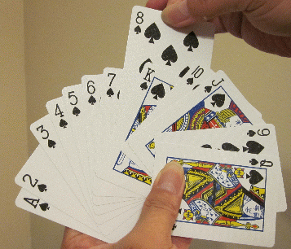
INSERTION SORT

Slide 53
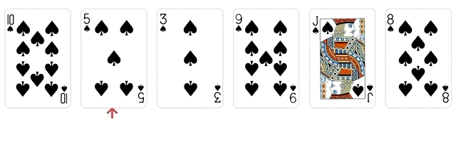
INSERTION SORT

Slide 54
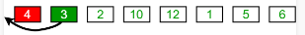
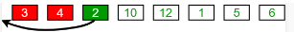
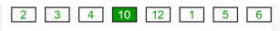
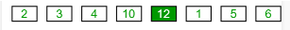
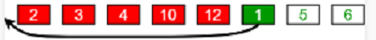

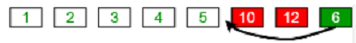
INSERTION SORT

Slide 55
INSERTION SORT
Algorithm
The simple steps of achieving the insertion sort are listed as follows –
Step 1 - If the element is the first element, assume that it is already sorted. Return 1.
Step2 - Pick the next element, and store it separately in a key.
Step3 - Now, compare the key with all elements in the sorted array.
Step 4 - If the element in the sorted array is smaller than the current element, then move to the next element. Else, shift greater elements in the array towards the right.
Step 5 - Insert the value.
Step 6 - Repeat until the array is sorted.

Slide 56
INSERTION SORT
void insertionSort(int a[ ], int n)
{
int i, j, key;
for (i = 1; i < n; i++)
{
key = a[i];
j = i - 1;
/* Move elements of a[0..i-1], that are greater than key,
to one position ahead of their current position */
while (j >= 0 && a[j] > key)
{
a[j + 1] = a[j];
j - - ;
}
a[j + 1] = key;
}
}

Slide 57
INSERTION SORT
Time Complexity
Best Case Complexity - It occurs when there is no sorting required, i.e. the array is already sorted. The best-case time complexity of insertion sort is O(n).
Average Case Complexity - It occurs when the array elements are in jumbled order that is not properly ascending and not properly descending. The average case time complexity of insertion sort is O(n²).
Worst Case Complexity - It occurs when the array elements are required to be sorted in reverse order. That means suppose you have to sort the array elements in ascending order, but its elements are in descending order. The worst-case time complexity of insertion sort is O(n²).

Slide 58
SHELL SORT
It is a sorting algorithm that is an extended version of insertion sort.
In insertion sort, at a time, elements can be moved ahead by one position only. To move an element to a far-away position, many movements are required that increase the algorithm's execution time.
Shell sort is the generalization of insertion sort, which overcomes the drawbacks of insertion sort by comparing elements separated by a gap of several positions.
This algorithm first sorts the elements that are far away from each other, then it subsequently reduces the gap between them. This gap is called as interval.

Slide 59
SHELL SORT
As similar to insertion sort, it is a comparison-based and in-place sorting algorithm. Shell sort is efficient for medium-sized data sets.
The interval between the elements is reduced based on the sequence used. Some of the optimal sequences that can be used in the shell sort algorithm are:
Shell's original sequence: N/2 , N/4 , …, 1

Slide 60
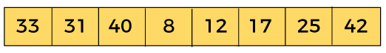
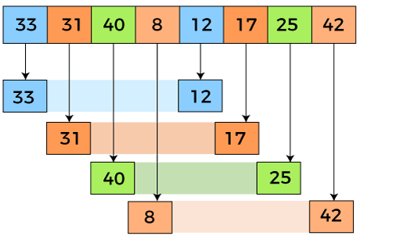
SHELL SORT
Example:
At the interval of 4, the sub lists are {33, 12}, {31, 17}, {40, 25}, {8, 42}.

Slide 61
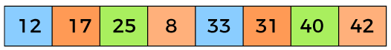
SHELL SORT

Slide 62
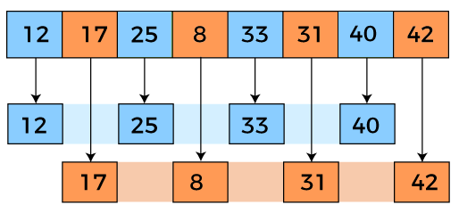
SHELL SORT
In the second loop, elements are lying at the interval of 2 (n/4 = 2), where n = 8.
Now, we are taking the interval of 2 to sort the rest of the array. With an interval of 2, two sub lists will be generated - {12, 25, 33, 40}, and {17, 8, 31, 42}.

Slide 63
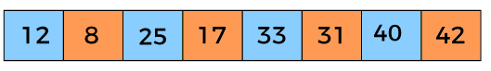
SHELL SORT
Now, we again have to compare the values in every sub-list. After comparing, we have to swap them if required in the original array. After comparing and swapping, the updated array will look as follows –

Slide 64
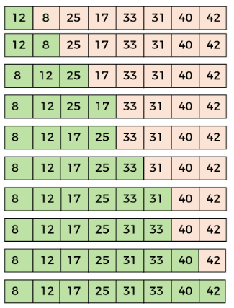
SHELL SORT
In the third loop, elements are lying at the interval of 1 (n/8 = 1),
where n = 8.
At last, we use the interval of value 1 to sort the rest of the array elements.
In this step, shell sort uses insertion sort to sort the array elements.

Slide 65
SHELL SORT
Algorithm:
Step 1 − Initialize the value of gap size. Example: h Step 2 − Divide the list into smaller sub-part. Each must have equal intervals to h Step 3 − Sort these sub-lists using insertion sort Step 4 – Repeat this step 2 until the list is sorted. Step 5 – Print a sorted list.

Slide 66
HEAP SORT
Heap sort is one of the sorting algorithms used to arrange a list of elements in order.
Heap sort algorithm uses one of the tree concepts called Heap Tree.
Let us first define a Complete Binary Tree. A complete binary tree is a binary tree in which every level, except possibly the last, is completely filled, and all nodes are as far left as possible.
A Binary Heap is a Complete Binary Tree where items are stored in a special order such that the value in a parent node is greater(or smaller) than the values in its two children nodes.
The former is called max heap and the latter is called min-heap.
The heap can be represented by a binary tree or array.

Slide 67
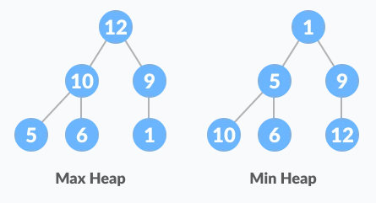
HEAP SORT

Slide 68
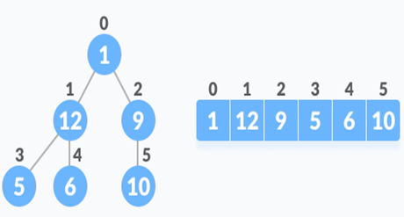
HEAP SORT
Relationship between Array Indexes and Tree Elements
A complete binary tree has an interesting property that we can use to find the children and parents of any node.
If the index of any element in the array is i,
the element in the index 2i+1 will become the left child and element in 2i+2 index will become the right child.
Also, the parent of any element at index i is given by the lower bound of (i-1)/2.

Slide 69
HEAP SORT
Algorithm
The Heap sort algorithm to arrange a list of elements in ascending order is performed using following steps...
Step 1 - Construct a Binary Tree with given list of Elements.
Step 2 - Transform the Binary Tree into Max Heap.
Step 3 - Delete the root element from Max Heap using Heapify method.
Step 4 - Put the deleted element into the Sorted list.
Step 5 - Repeat the same until Max Heap becomes empty.
Step 6 - Display the sorted list.

Slide 70
BUCKET SORT
Bucket Sort is a sorting technique that sorts the elements by first dividing the elements into several groups called buckets.
The elements inside each bucket are sorted using any of the suitable sorting algorithms or recursively calling the same algorithm.
The process of bucket sort can be understood as a scatter-gather approach.
The elements are first scattered into buckets then the elements of buckets are sorted. Finally, the elements are gathered in order.

Slide 71
BUCKET SORT
The basic procedure of performing the bucket sort is given as follows –
First, partition the range into a fixed number of buckets.
Then, toss every element into its appropriate bucket.
After that, sort each bucket individually by applying a sorting algorithm.
And at last, concatenate all the sorted buckets.
Bucket sort is mainly useful when input is uniformly distributed over a range.

Slide 72

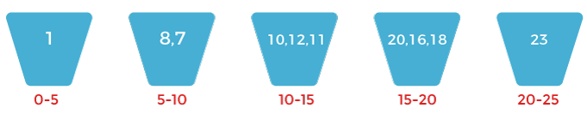
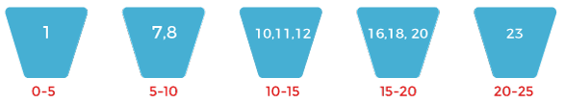

BUCKET SORT
Scattering of array elements
Sort each bucket individually
Gather the sorted elements from each bucket in order

Slide 73
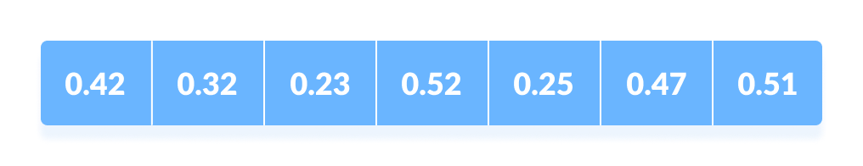
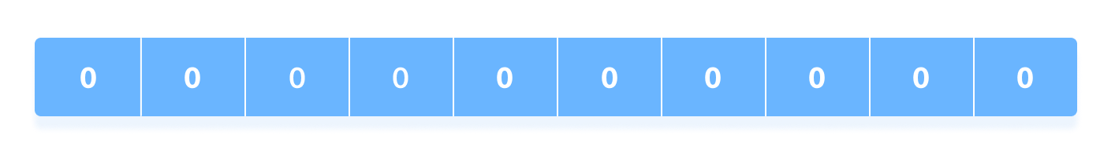
BUCKET SORT
Suppose, the input array is:
Create an array of size 10. Each slot of this array is used as a bucket for storing elements.
Insert elements into the buckets from the array. The elements are inserted according to the range of the bucket.
In our example code, we have buckets each of ranges from 0 to 1, 1 to 2, 2 to 3,...... (n-1) to n.
Suppose, an input element is .23 is taken. It is multiplied by size = 10 (ie. .23*10=2.3). Then, it is converted into an integer (ie. 2.3≈2). Finally, .23 is inserted into bucket-2.

Slide 74
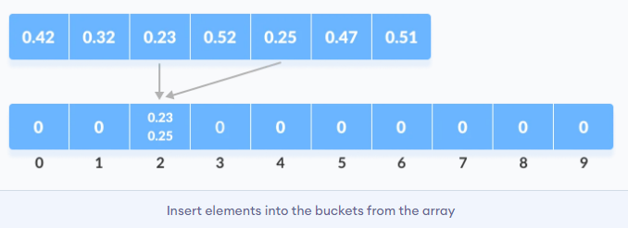
BUCKET SORT
Similarly, .25 is also inserted into the same bucket. Every time, the floor value of the floating point number is taken.
Similarly, other elements are inserted into their respective buckets.

Slide 75
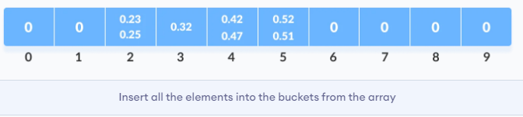
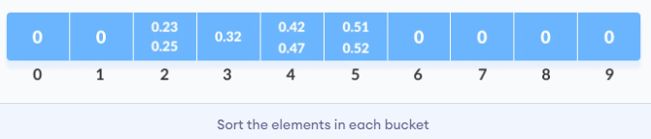
BUCKET SORT
The elements of each bucket are sorted using any of the stable sorting algorithms.

Slide 76
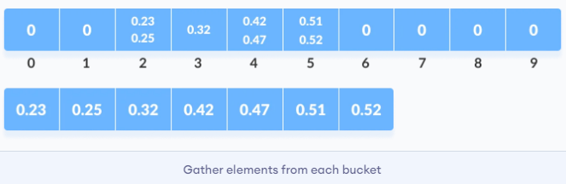
BUCKET SORT
The elements from each bucket are gathered.
It is done by iterating through the bucket and inserting an individual element into the original array in each cycle.

Slide 77
COUNTING SORT
Counting sort is a sorting technique that is based on the keys between specific ranges.
This sorting technique doesn't perform sorting by comparing elements.
It performs sorting by counting objects having distinct key values.
After that, it performs some arithmetic operations to calculate each object's index position in the output sequence.
Counting sort makes assumptions about the data, for example, it assumes that values are going to be in the range of 0 to 10 or 10 – 99 etc.
It uses a temporary array making it a non In Place algorithm.

Slide 78
RADIX SORT
Radix sort is a sorting technique that sorts the elements by first grouping the individual digits of the same place value.
Then, sort the elements according to their increasing/decreasing order.
Find the maximum digit number from array and convert all digit into that max number.
Ex. 01, 123, 2345
Max digit is 4.
0001, 0123, 2345.

Slide 79
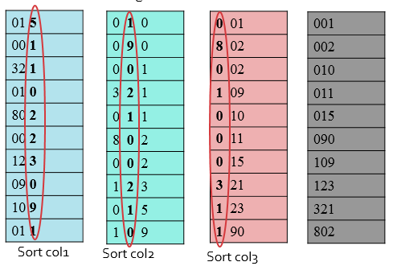
RADIX SORT
Convert all digit into 3 digit number.

Slide 80
RECURSION TREE METHOD
1. Recursion Tree Method is a pictorial representation of an iteration method which is in the form of a tree where at each level nodes are expanded.
2. In general, we consider the second term in recurrence as root.
3. It is useful when the divide & Conquer algorithm is used.
In Recursion tree, each root and child represents the cost of a single subproblem.
5. We sum the costs within each of the levels of the tree to obtain a set of pre-level costs and then sum all pre-level costs to determine the total cost of all levels of the recursion.
6. A Recursion Tree is best used to generate a good guess, which can be verified by the Substitution Method.

Slide 81
RECURSION TREE METHOD
Solution-
Step-01: Draw a recursion tree based on the given recurrence relation.
The given recurrence relation shows-
A problem of size n will get divided into 2 sub-problems of size n/2.
Then, each sub-problem of size n/2 will get divided into 2 sub-problems of size n/4 and so on.
At the bottom most layer, the size of sub-problems will reduce to 1.
Solve the following recurrence relation using recursion tree method-
T(n) = 2T(n/2) + n

Slide 82
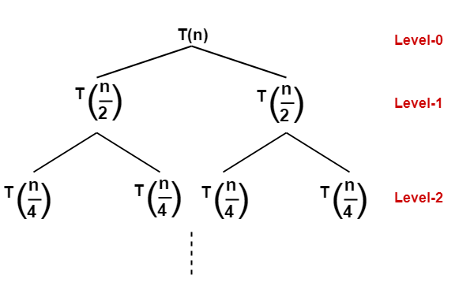
RECURSION TREE METHOD

Slide 83
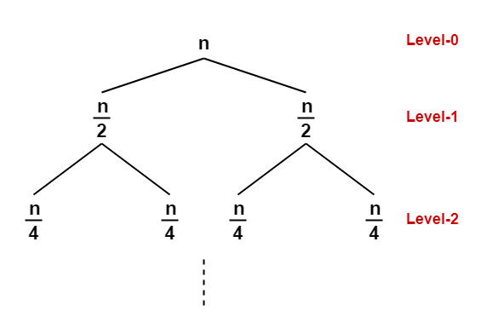
RECURSION TREE METHOD

Slide 84
RECURSION TREE METHOD
The given recurrence relation shows-
The cost of dividing a problem of size n into its 2 sub-problems and then combining its solution is n.
The cost of dividing a problem of size n/2 into its 2 sub-problems and then combining its solution is n/2 and so on.
This is illustrated through following recursion tree where each node represents the cost of the corresponding sub-problem-

Slide 85
RECURSION TREE METHOD
Step-02:
Determine cost of each level-
Cost of level-0 = n
Cost of level-1 = n/2 + n/2 = n
Cost of level-2 = n/4 + n/4 + n/4 + n/4 = n and so on.

Slide 86
RECURSION TREE METHOD
Step-03:
Determine total number of levels in the recursion tree-
Size of sub-problem at level-0 = n/2⁰
Size of sub-problem at level-1 = n/2¹
Size of sub-problem at level-2 = n/2²
Continuing in similar manner, we have- Size of sub-problem at level-k = n/2^{k}

Slide 87
RECURSION TREE METHOD
Suppose at level-k (last level), size of sub-problem becomes 1. Then-
n / 2^{k} = 1
2^{k} = n
Taking log on both sides, we get- k = log₂n

